Slide 1


INDIAN POSTAL DELIVERY AUTOMATION
By
Paluru Surya Kiran RA1911026010057
Darshan Ramesh RA1911026010011
Problem Statement

Slide 2
Problem Statement
INDIAN POSTAL DELIVERY AUTOMATION
The Indian Postal Service is facing challenges in managing and processing the large volume of postal deliveries across the country. Manual processes and outdated systems are leading to delays, errors, and inefficiencies in sorting, and delivering the mail.
The need of the hour is to automate and modernize the postal system to improve its efficiency, speed, and accuracy. The project aims to build a complete automated system that can read the address on the envelope and points to precise location with minimal human intervention.
Abstract

Slide 3
Abstract
Problem Statement
The Indian Postal Automation project aims to address the inefficiency and challenge in India's existing manual postal system.
This project aims to design and implement an automated postal system that can improve the speed and accuracy of postal operations while reducing the cost of operations.
This paper addresses the most common and essential problem in the postal department of parcel segregation tasks by proposing a fully-automated solution.
The proposed methodology uses CRNN network for handwritten address recognition, followed by address parsing techniques and the construction of knowledge graphs to pinpoint the accurate location of the delivery.
This proposed solution can bring the parcel segregation process from hours to minutes.
Introduction

Slide 4
Abstract
Introduction
India is one of the world's most significant postal systems, with roughly 1.5 lakh post offices and around 6 lakh post boxes for collecting packages.
The CRNN (Convolutional Recurrent Neural Network) is a popular deep learning model that combines convolutional and recurrent layers to perform sequence recognition tasks.
It has been extensively utilized in many different applications, including OCR, speech recognition, and picture captioning.

Slide 5
Introduction
An address parser typically consists of several components, including tokenization, NER, and address parsing.
The tokenization component segments the input text into individual words, and the NER component labels each word with its corresponding named entity tag, such as "street name" or "city".
The address parsing component then uses labeled entities to extract the relevant information from the address.
Motivation

Slide 6
Introduction
Motivation
Every day, millions of letters and couriers are delivered worldwide. Indian postal services earn around 1700 crores per annum and is said to be world's most widely distributed postal system, with a collection of around 1.5 lakh post offices.
More than 100 million parcels are delivered every year on average There are almost 6Lac post boxes from which letters are collected.
The conventional manual sorting method used to separate letters based on their destination is time-consuming and inefficient incurring loss of resources in the industry.
Literature Survey

Slide 7
Motivation
Literature Survey
Year | Name | Author | Methodology
2021 | Multinational Address Parsing: A Zero-Shot Evaluation | Marouane Yassine, David Beauchemin, Franc¸ois Laviolette, Luc Lamontagn | Multinational address parsing using a Recurrent Neural Network (RNN)
2019 | Neural Chinese Address Parsing | Hao Li , Wei Lu, Pengjun Xie, Linlin Li | Neural network based approach
2019 | Bangladeshi Post Office Automation System Using Neural Network | Mustain Billah, Md. Kamruzzaman Ruman, Nazmus Sadat, Md. Mahfuzul Islam | Checking positional and statistical features like GLCM, LBP, Histogram of oriented gradients
2019 | CNN-based Hindi Numeral String Recognition for Indian Postal Automation | Hongjian Zhan, Shujing Lyu, Umapada Pal, Yue Lu | Convolutional Neural Network and Connectionist temporal classification

Slide 8
Literature Survey
2018 | DeepParse: Trainable Postal Address Parser - | Nosheen Abid , Adnan ul Hasan and Faisal Shafait | Neural Networks
2018 | Automatic Chinese Postal Address Block Location Using Proximity Descriptors and Cooperative Profit Random Forests | Xinghui Dong , Junyu Dong , Huiyu Zhou , Jianyuan Sun , and Dacheng Tao | Generate descriptors using Two proximity descriptors encoding and use those descriptors with CPRF
2017 | Pincode detection using Deep CNN for Postal Automation | Nabin Sharma, Abira Sengupta, Rabi Sharma, Umapada Pal and Michael Blumenstein | VGG_M
2016 | A Probabilistic Address Parser using Conditional Random Fields and Stochastic Regular Grammar | Minlue Wang, Valeriia Haberland, Amos Yeo, Andrew Martin, John Howroyd and J. Mark Bishop | Markov CRF

Slide 9
Literature Survey
2014 | HMM-based Address Parsing: Efficiently Parsing Billions of Addresses on MapReduce | Xiang Li, Hakan Kardes, Xin Wang, Ang Sun | HMM
2013 | Tamil Handwritten City Name Database Development and Recognition for Postal Automation | S. Thadchanamoorthy, N. D. Kodikara; H.L.Premaratne, Umapada Pal, Fumitaka Kimura | MQFD for likelihood estimation of a letter
2017 | A Font style classification system for English OCR | Bharath V, N. Shobha Rani | technique for classification of the font style based on character image is proposed by employing the distance profile features with respect to left, right and diagonal directions of a character image.
Challenges and limitations in existing system

Slide 10
Literature Survey
2017 | Error Detection and Corrections in Indic OCR using LSTMs | Rohit Saluja, Devaraj Adiga, Parag Chaudhuri, Ganesh Ramakrishnan, Mark Carman | a Long Short-Term Memory (LSTM) based character level language model with a fixed delay for discriminative language modeling in the context of OCR errors for jointly addressing the problems of error detection and correction in Indic OCR
2019 | Deep Statistical Analysis of OCR Errors for Effective Post-OCR Processing | Thi-Tuyet-Hai Nguyen L3i, Adam Jatowt Graduate Mickael Coustaty L3i, Nhu-Van Nguyen L3i, Antoine Doucet L3i, | Five aspects related to general OCR errors are studied and compared with human-generated misspellings, including edit operations, length effects, erroneous character positions, real-word vs. non-word errors, and word boundaries.
Challenges and limitations in existing system

Slide 11
Literature Survey
2019 | Unsupervised OCR Model Evaluation Using GAN | Abhash Sinha, Martin Jenckel, Syed Saqib Bukhari, Andreas Dengel | OCR model evaluation with Generative Adaptive Neural networks.
2020 | Deep Learning Based Sinhala Optical Character Recognition (OCR) | Isuri Anuradha, Chamila Liyanage, Harsha Wijayawardhana, Ruvan Weerasinghe | Tesseract OCR based model
2021 | Automatic Identification of Addresses: A Systematic Literature Review | Paula Cruz, Leonardo Vanneschi, Marco Painho and Paulo Rita | HMM with CRF augmentation based approach
2021 | PostMatch: A framework for efficient address matching | Darren Yates, Zahidul Islam, Yanchang Zhao, Richi Nayak, Vladimir Estivill-Castro, Salil Kanhere | HMM and neural network based approach
Challenges and limitations in existing system

Slide 12
Literature Survey
2019 | AddressNet: A robust street address parser | Jason Rigby | GRU type of RNN with LSTM
2021 | Global Postal Automation | Aimee Vachon, Leslie Ordonez, Jorge Fonseca | New Field theory with OCR
2018 | A study of Optical Character Patterns identified by different OCR Algorithms | Purna Vithlani, Dr. C. K. Kumbharana | Neural Network Algorithm and Support Vector Machine Algorithm are presented in this paper.
Challenges and limitations in existing system

Slide 13
Literature Survey
Challenges and limitations in existing system
There is no address parser exists for Indian addresses exists (to the best of my knowledge), and mostly previous models are pin-code based that fails to work in case of wrongly detected pin-code.
Existing models are unable to identify Indian regional address terms like nagar, marg that are very common into consideration and fails to respond for those.
Rule-based techniques are computationally efficient and provide promising results on standardized addresses but are limited in terms of classification and require intense domain knowledge
Objectives of the project

Slide 14
Challenges and limitations in existing system
Objectives of the project
Design and build an OCR model to recognize the handwritten text written on the postal card.
Design and build an address parser for parsing the address information form the text extracted from the OCR model.
Construction of Knowledge graph from the data returned by the address parser.
Generation of exact location from the data in knowledge graph.
Innovation idea of the project

Slide 15
Objectives of the project
Innovation idea of the project
There is no previous model exists that is fully automated with minimal human intervention. We are aiming to design an efficient solution that is fully automated as well as easy to use.
There is no address parser designed for Indian postal address. Current Indian postal automation projects are limited to pin-code detection and segregation based on the pin-code. We are aiming to design the project that can take address into consideration and minimize the error of delivery to a greater extent.
Scope and applications of project

Slide 16
Innovation idea of the project
Scope and applications of project
Indian postal service had a revenue of over 10000 crores(2021 - 2022), yet postal service experiencing loss since 2010. The reason behind this is huge man power getting wasted. The proposed solution will be able to help the postal services with swift and efficient service.
The solution will be an aid to the Indian postal services with requirement of lesser man power along with quicker processing times, thereby reducing costs, resulting in a way for profits.
Architecture

Slide 17
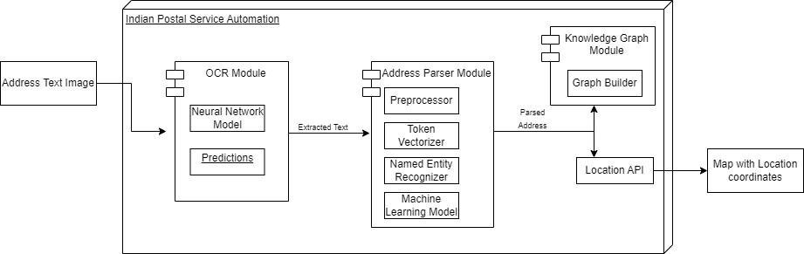
Scope and applications of project
Architecture
Dataflow diagram level 0

Slide 18
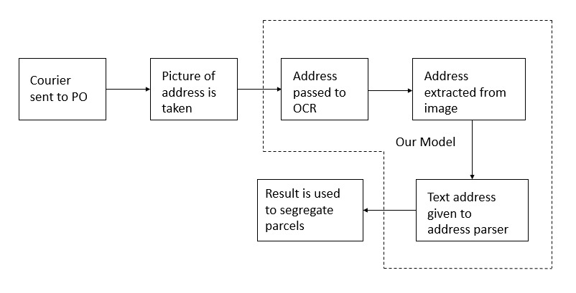
Architecture
Dataflow diagram level 0
OCR model Output

Slide 19
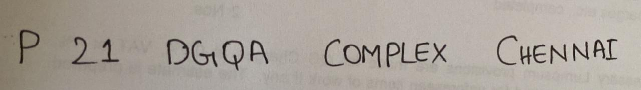
Architecture
OCR model Output
Input:
Output:
Address Parser module Output

Slide 20
OCR model Output
Address Parser module Output
Input:
Output:
Knowledge Graph Output

Slide 21
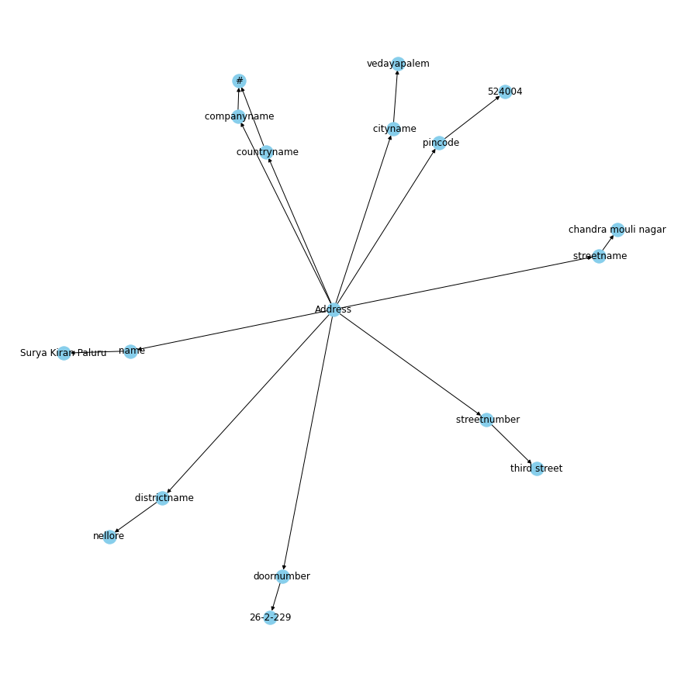
Address Parser module Output
Knowledge Graph Output

Slide 22
Thank You

